Slide 1
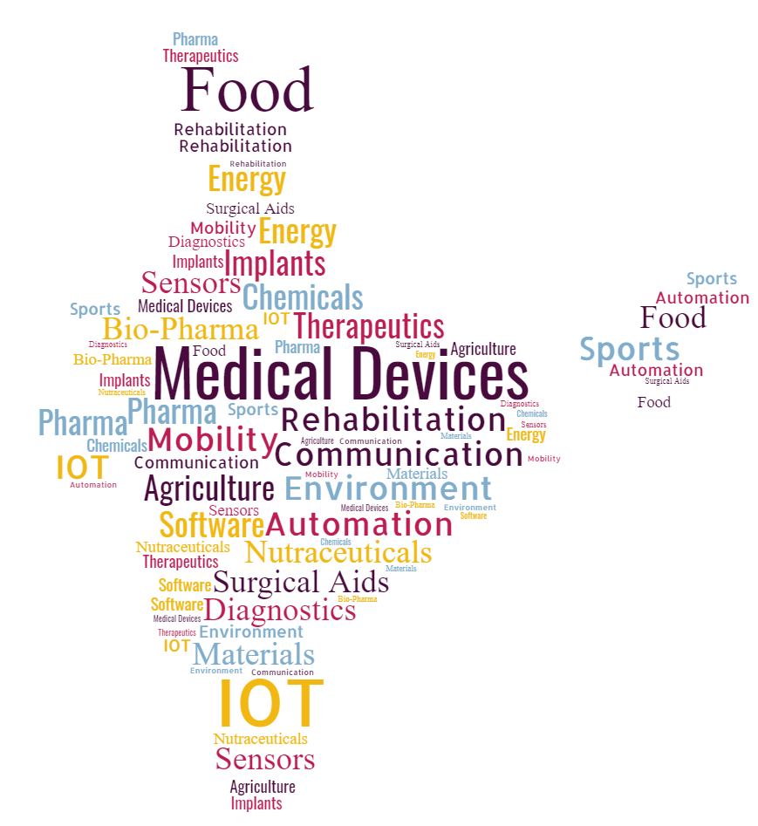
Start-ups of Venture Center
Across Industry Sectors
Incubatee Showcase | December 2021

Slide 2
Medical Devices-Implants and surgical aids
Eishita Healthtech Pvt Ltd

Slide 3
Medical Devices – Mechanical, electronics, optics, computing

Slide 4
Rehabilitation & Sports
Afferent Wearable Technologies

Slide 5
Diagnostics
Virtual Sense Global
Mandala
Axolotl health

Slide 6
Therapeutics, Pharma, Biopharma
Neel Agil

Slide 7
Energy and environment
Orayna Solutions

Slide 8
Agriculture and food

Slide 9
Industrial automation, sensors, IOT, mobility, drones, modeling tools, software, communication

Slide 10
Nutraceuticals, fragrances, colors, surfactants, chemicals, materials and industrial processes
Amnium Technologies
HarvestWild Organic

Slide 11
Thank you.
Soma Chattopadhyay
Head, Incubation and Mentoring
managerincubator@venturecenter.co.in
+91-91722-32211

